Slide 1
ENGINEERING ECONOMICS
ECO-300
FA 18-batch, FA20 class, Section A&B
(Online lecture)
ELASTICITY AND ITS APPLICATION

Slide 2
Disclaimer
All the topics followed in this lecture are from Principles of microeconomics, by N. G. Mankiw 4th Edition, which is being used as a one of the standard textbook for this course. The data taken from the book is entirely for study purposes and no copyright infringement is intended.

Slide 3
ELASTICITY AND ITS APPLICATION
Chapter 5
ELASTICITY AND ITS APPLICATION

Slide 4
Elasticity
0
Basic idea:
Elasticity measures how much one variable responds to changes in another variable.
  One type of elasticity measures how much demand for your commodity will fall if you raise your price.
Definition:
Elasticity is a numerical measure of the responsiveness of Q^{d} or Q^{s} to one of its determinants.
ELASTICITY AND ITS APPLICATION
Notes:
Here, Q^{d} and Q^{s} are short for quantity demanded and quantity supplied, as in the PowerPoint for Chapter 4.

Slide 5
Price Elasticity of Demand
0
Price elasticity of demand
Percentage change in Q^{d}
=
Percentage change in P
Price elasticity of demand measures how much Q^{d} responds to a change in P.
Loosely speaking, it measures the price-sensitivity of buyers’ demand.
ELASTICITY AND ITS APPLICATION

Slide 6
Price Elasticity of Demand
0
Price elasticity of demand
Percentage change in Q^{d}
=
Percentage change in P
P
Example:
P rises by 10%
Price elasticity
of demand equals
P₂
P₁
D
15%
Q
= 1.5
Q₂
Q₁
10%
Q falls by 15%
ELASTICITY AND ITS APPLICATION

Slide 7
Price Elasticity of Demand
0
Price elasticity of demand
Percentage change in Q^{d}
=
Percentage change in P
P
Along a D curve, P and Q move in opposite directions, which would make price elasticity negative.
We will drop the minus sign and report all price elasticities as
positive numbers.
P₂
P₁
D
Q
Q₂
Q₁
ELASTICITY AND ITS APPLICATION
Notes:
It might be worth explaining to your students that “P and Q move in opposite directions” means that the percentage change in Q and the percentage change in P will have opposite signs, thus implying a negative price elasticity.
To be consistent with the text, the last statement in the green box says that we will report all price elasticities as positive numbers. It might be slightly more accurate to say that we will report all elasticities as non-negative numbers: we want to allow for the (admittedly rare) case of zero elasticity.

Slide 8
Calculating Percentage Changes
0
Standard method
of computing the percentage (%) change:
Demand for your websites
end value – start value
P
x 100%
start value
B
$250
A
Going from A to B,
the % change in P equals
$200
D
($250–$200)/$200 = 25%
Q
8
12
ELASTICITY AND ITS APPLICATION

Slide 9
Calculating Percentage Changes
0
Problem:
The standard method gives different answers depending on where you start.
Demand for your websites
P
From A to B,
P rises 25%, Q falls 33%,
elasticity = 33/25 = 1.33
From B to A,
P falls 20%, Q rises 50%, elasticity = 50/20 = 2.50
B
$250
A
$200
D
Q
8
12
ELASTICITY AND ITS APPLICATION

Slide 10
Calculating Percentage Changes
0
So, we instead use the midpoint method:
end value – start value
x 100%
midpoint
The midpoint is the number halfway between the start & end values, the average of those values.
It doesn’t matter which value you use as the “start” and which as the “end” – you get the same answer either way!
ELASTICITY AND ITS APPLICATION

Slide 11
Calculating Percentage Changes
0
Using the midpoint method, the % change
in P equals
$250 – $200
x 100%
= 22.2%
$225
The % change in Q equals
12 – 8
x 100%
= 40.0%
10
The price elasticity of demand equals
40/22.2 = 1.8
ELASTICITY AND ITS APPLICATION
Notes:
These calculations are based on the example shown a few slides back: points A and B on the website demand curve.

Slide 12
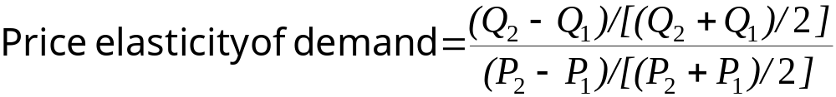
The Elasticity of Demand
Midpoint method
  Two points: (Q₁, P₁) and (Q₂, P₂)

Slide 13
A C T I V E L E A R N I N G 1
Calculate an elasticity using mid point method
Use the following
information to
calculate the
price elasticity
of demand
for hotel rooms:
if P = $70, Q^{d} = 5000
if P = $90, Q^{d} = 3000

Slide 14
EXAMPLE:
Insulin vs. Caribbean Cruises
0
The prices of both of these goods rise by 20%.
For which good does Q^{d} drop the most? Why?
  To millions of diabetics, insulin is a necessity.
  A rise in its price would cause little or no decrease in demand.
  A cruise is a luxury. If the price rises,
  some people will forego it.
Lesson: Price elasticity is higher for luxuries than for necessities.
ELASTICITY AND ITS APPLICATION

Slide 15
The Determinants of Price Elasticity:
0
  Availability of close substitutes
    Goods with close substitutes
      More elastic demand
  Necessities vs. luxuries
    Necessities – inelastic demand
    Luxuries – elastic demand
  Definition of the market
    Narrowly defined markets – more elastic demand
  Time horizon
      More elastic over longer time horizons
ELASTICITY AND ITS APPLICATION
Notes:
This slide is a convenience for your students, and replicates a similar table from the text.
If you’re pressed for time, it is probably safe to omit this slide from your presentation.

Slide 16
The Variety of Demand Curves
0
The price elasticity of demand is closely related to the slope of the demand curve.
Rule of thumb:
The flatter the curve, the bigger the elasticity.
The steeper the curve, the smaller the elasticity.
Five different classifications of D curves.…
ELASTICITY AND ITS APPLICATION
Notes:
Economists classify demand curves according to their elasticity.
The next 5 slides present the five different classifications, from least to most elastic.

Slide 17
“Perfectly inelastic demand” (one extreme case)
0
Price elasticity
of demand
% change in Q
0%
=
=
= 0
% change in P
10%
D curve:
P
D
vertical
P₁
Consumers’
price sensitivity:
P₂
none
P falls by 10%
Q
Elasticity:
Q₁
0
Q changes
by 0%
ELASTICITY AND ITS APPLICATION
Notes:
If Q doesn’t change, then the percentage change in Q equals zero, and thus elasticity equals zero.
It is hard to think of a good for which the price elasticity of demand is literally zero. Take insulin, for example. A sufficiently large price increase would probably reduce demand for insulin a little, particularly among people with very low incomes and no health insurance.
However, if elasticity is very close to zero, then the demand curve is almost vertical. In such cases, the convenience of modeling demand as perfectly inelastic probably outweighs the cost of being slightly inaccurate.

Slide 18
“Inelastic demand”
0
Price elasticity
of demand
% change in Q
< 10%
=
=
< 1
% change in P
10%
D curve:
P
relatively steep
P₁
Consumers’
price sensitivity:
P₂
relatively low
D
P falls by 10%
Q
Elasticity:
Q₁
Q₂
< 1
Q rises less than 10%
ELASTICITY AND ITS APPLICATION
Notes:
An example: Student demand for textbooks that their professors have required for their courses.
Here, it’s a little more clear that elasticity would be small, but not zero. At a high enough price, some students will not buy their books, but instead will share with a friend, or try to find them in the library, or just take copious notes in class.
Another example: Gasoline in the short run.

Slide 19
“Unit elastic demand”
0
Price elasticity
of demand
% change in Q
10%
=
=
= 1
% change in P
10%
D curve:
P
intermediate slope
P₁
Consumers’
price sensitivity:
P₂
intermediate
D
P falls by 10%
Q
Elasticity:
Q₁
Q₂
1
Q rises by 10%
ELASTICITY AND ITS APPLICATION
Notes:
This is the intermediate case: the demand curve is neither relatively steep nor relatively flat. Buyers are neither relatively price-sensitive nor relatively insensitive to price.
(This is also the case where price changes have no effect on revenue.)

Slide 20
“Elastic demand”
0
Price elasticity
of demand
% change in Q
> 10%
=
=
> 1
% change in P
10%
D curve:
P
relatively flat
P₁
Consumers’
price sensitivity:
P₂
D
relatively high
P falls by 10%
Q
Elasticity:
Q₁
Q₂
> 1
Q rises more than 10%
ELASTICITY AND ITS APPLICATION
Notes:
A good example here would be breakfast cereal, or nearly anything with readily available substitutes.
An elastic demand curve is flatter than a unit elastic demand curve (which itself is flatter than an inelastic demand curve).

Slide 21
“Perfectly elastic demand” (the other extreme)
0
Price elasticity
of demand
% change in Q
any %
=
=
= infinity
% change in P
0%
D curve:
P
horizontal
P₂ =
P₁
D
Consumers’
price sensitivity:
extreme
P changes by 0%
Q
Elasticity:
Q₁
Q₂
infinity
Q changes
by any %
ELASTICITY AND ITS APPLICATION
Notes:
“Extreme price sensitivity” means the tiniest price increase causes demand to fall to zero.
“Q changes by any %” – when the D curve is horizontal, quantity cannot be determined from price. Consumers might demand Q1 units one month, Q2 units another month, and some other quantity later. Q can change by any amount, but P always “changes by 0%” (i.e., doesn’t change).
If perfectly inelastic is one extreme, this case (perfectly elastic) is the other.
Here’s a good real-world example of a perfectly elastic demand curve, which foreshadows an upcoming chapter on firms in competitive markets. Suppose you run a small family farm in Iowa. Your main crop is wheat. The demand curve in this market is downward-sloping, and the market demand and supply curves determine the price of wheat. Suppose that price is $5/bushel.
Now consider the demand curve facing you, the individual wheat farmer. If you charge a price of $5, you can sell as much or as little as you want. If you charge a price even just a little higher than $5, demand for YOUR wheat will fall to zero: Buyers would not be willing to pay you more than $5 when they could get the same wheat elsewhere for $5. Similarly, if you drop your price below $5, then demand for YOUR wheat will become enormous (not literally infinite, but “almost infinite”): if other wheat farmers are charging $5 and you charge less, then EVERY buyer will want to buy wheat from you.
Why is the demand curve facing an individual producer perfectly elastic? Recall that elasticity is greater when lots of close substitutes are available. In this case, you are selling a product that has many perfect substitutes: the wheat sold by every other farmer is a perfect substitute for the wheat you sell.

Slide 22
The Elasticity of Demand
Total revenue
  Amount paid by buyers
  Received by sellers of a good
  Computed as: price of the good times the quantity sold (P ˣ Q)

Slide 23
Total revenue
2
Price
1. an
$4
P ˣ Q=$400
(revenue)
Demand
P
0
100
Quantity
Q
The total amount paid by buyers, and received as revenue by sellers, equals the area of the box under the demand curve, P × Q. Here, at a price of $4, the quantity demanded is 100, and total revenue is $400.

Slide 24
The Elasticity of Demand
Total revenue and price elasticity of demand
Inelastic demand
  Increase in price
    Increase in total revenue
Elastic demand
  Increase in price
    Decrease in total revenue

Slide 25
How total revenue changes when price changes (a)
3
(a) The Case of Inelastic Demand
Price
Price
1. an
1. an
$3
Revenue=$240
$1
Demand
Demand
Revenue=$100
0
100
Quantity
0
80
Quantity
The impact of a price change on total revenue (the product of price and quantity) depends on the elasticity of demand. In panel (a), the demand curve is inelastic. In this case, an increase in the price leads to a decrease in quantity demanded that is proportionately smaller, so total revenue increases. Here an increase in the price from $1 to $3 causes the quantity demanded to fall from 100 to 80. Total revenue rises from $100 to $240

Slide 26
How total revenue changes when price changes (b)
3
(b) The Case of Elastic Demand
Price
Price
1. an
1. an
$5
$4
Revenue
=$200
Revenue=$100
Demand
Demand
0
50
Quantity
0
20
Quantity
The impact of a price change on total revenue (the product of price and quantity) depends on the elasticity of demand. In panel (b), the demand curve is elastic. In this case, an increase in the price leads to a decrease in quantity demanded that is proportionately larger, so total revenue decreases. Here an increase in the price from $4 to $5 causes the quantity demanded to fall from 50 to 20. Total revenue falls from $200 to $100.
.

Slide 27
The Elasticity of Demand
When demand is inelastic
  Price and total revenue move in the same direction
When demand is elastic
  Price and total revenue move in opposite directions
If demand is unit elastic
  Total revenue remains constant when the price changes

Slide 28
Other Elasticities
Income elasticity of demand: measures the response of Q^{d} to a change in consumer income
Income elasticity of demand
Percent change in Q^{d}
=
Percent change in income
∆q
----------
q
= -----------------
∆Y
-------
Y
Income elasticity of
demand
ELASTICITY AND ITS APPLICATION
Notes:
This topic and the next one (cross-price elasticity) do not appear anywhere else in the book. Instructors who are pressed for time may consider cutting these topics.
(This is merely my suggestion, not the official position of Greg Mankiw or Cengage/South-Western.)

Slide 29
Income elasticity of demand schedule
Income (Y) | Qd
500 | 20
600 | 25
∆Y= 100 | ∆q= 5

Slide 30
∆q
----------
q
EY= -----------------
∆Y
-------
Y
5
----------
20
EY= -----------------
100
-------
500

Slide 31
EY= 1.25
Or
EY>1

Slide 32
Income Elasticity
Types of Goods
  Normal Goods
  Inferior Goods
Higher income raises the quantity demanded for normal goods but lowers the quantity demanded for inferior goods.

Slide 33
Income Elasticity
Goods consumers regard as necessities tend to be income inelastic
  Examples include food, fuel, clothing, utilities, and medical services.
Goods consumers regard as luxuries tend to be income elastic.
  Examples include sports cars, furs, and expensive foods.

Slide 34
Other Elasticities
Cross-price elasticity of demand:
measures the response of demand for one good to changes in the price of another good
Cross-price elast.
of demand
% change in Q^{d} for good 1
=
% change in price of good 2
For substitutes, cross-price elasticity > 0
(e.g., an increase in price of beef causes an increase in demand for chicken)
For complements, cross-price elasticity < 0
(e.g., an increase in price of computers causes decrease in demand for software)
ELASTICITY AND ITS APPLICATION

Slide 35
Cross Elasticity of Demand
Under cross elasticity of demand (EC) change in the price of (B) Commodity results a change in the demand for commodity (A), While the Price of (A) remains the same.

Slide 36
Computing Income Elasticity
Cross elasticity of
demand
∆qA
----------
qA
= -----------------
∆pB
-------
pB

Slide 37
Cross elasticity of demand schedule
Commodities | Price (Rs) for 40 kg | Qd kg
Wheat A PA | 1600 | 40
 |  | 50 10= ∆qA
Rice B PB | 2000
 | 2500 500= ∆pB

Slide 38
∆qA
----------
qA
EC= -----------------
∆pB
-------
pB
10
----------
40
EC= -----------------
500
-------
2000

Slide 39
EC= 1
Or
Equal to unity

Slide 40
Elasticity of supply
This measures the responsiveness of quantity supplied to a change in price.
The price elasticity of supply (PES) is measured by
% change in Q.S / % change in price.
If price of a apple increases 10%, and the supply increases 20%. We say the PES is 2.0
If the price of bananas falls 12% and the quantity supplied falls 2%. We say the PES = 2/12 = 0.16
ELASTICITY AND ITS APPLICATION

Slide 41
Price Elasticity of Supply
0
Price elasticity of supply
Percentage change in Q^{s}
=
Percentage change in P
P
Example:
S
P rises by 8%
Price
elasticity
of supply equals
P₂
P₁
Q
16%
Q₁
Q₂
= 2.0
8%
Q rises by 16%
ELASTICITY AND ITS APPLICATION

Slide 42
Time period important
Short time- little adjustment possible as in short run supply can be changed only up to certain limit it depends upon the quantity available in stock, provision of an extra shift in production unit and existing productive capacity of the industry. In this period neither new firm can be established nor the exist size of the firm can be changed.

Slide 43
Long time – lots of adjustment possible
In long period there is sufficient time to change the size of the existing plant and new firm can also be established. There is a big scope of extraction or contraction of supply due to changing requirements in demand.

Slide 44
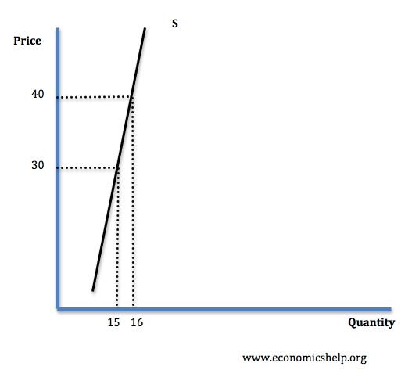
Inelastic supply
This means that an increase in price leads to a smaller % change in supply. Therefore PES <1
ELASTICITY AND ITS APPLICATION

Slide 45
Supply could be inelastic for the following reasons
Firms operating close to full capacity.
Firms have low levels of stocks, therefore there are no surplus goods to sell
In the short term, capital is fixed e.g. firms do not have time to build a bigger factory.
With agricultural products supply is inelastic in the short run, because it takes at least six months to grow crops, in September the farmer cannot suddenly produce more potatoes if the price goes up.
ELASTICITY AND ITS APPLICATION

Slide 46
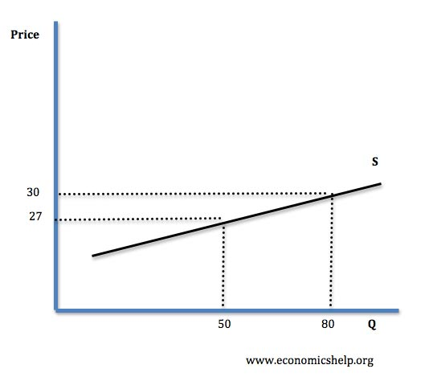
Elastic supply
This occurs when an increase in price leads to a bigger % increase in supply, therefore PES >1
ELASTICITY AND ITS APPLICATION

Slide 47
Supply could be elastic for the following reasons
If there is spare capacity in the factory.
If there are stocks available.
In the long run supply will be more elastic because capital can be varied.
If it is easy to employ more factors of production.
ELASTICITY AND ITS APPLICATION

Slide 48
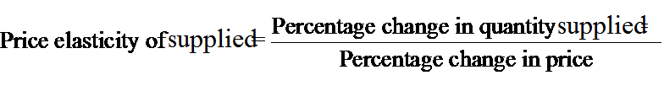
Computing the Price Elasticity of Supply
Percentage method
The price elasticity of supply is computed as the percentage change in the quantity supplied divided by the percentage change in price.

Slide 49
Formula method
∆qs
----------
qs
ES= -----------------
∆P
-------
P
It can be measured with the help of following formula:

Slide 50
Example
Price (P) | Qs
10 | 20
12 | 24
∆P= 2 | ∆qs= 4

Slide 51
∆qs
----------
qs
E= -----------------
∆P
-------
P
4
----------
20
E= -----------------
2
-------
10
E = 1

Slide 52
Factor influencing the elasticity of Supply
Nature of goods
  Perishable or durable goods
Change in production techniques
  New discoveries and modern methods
Productive capacity of industry
  Full capacity or reserve capacity (below full capacity)

Slide 53
Time period
  Day to day market or long period market
Other factors
  Trade restriction and backward means of transportation
  or
  Free trade policy and developed means of transportation.

Slide 54
The end
ELASTICITY AND ITS APPLICATION

